Slide 1
TYPING MASTER
Presented by:
Nirmal Baruwal
Nischal Khadka
Krishna Mandal

Slide 2
ABSTRACT
“Typing Master” is a Tutorial software to develop the typing speed where user
should be used to train the speed and accuracy of typing word. Typing is now an essential
part of almost every job imaginable. It helps you to complete your work faster and more
efficiently, be comfortable with the computer and help communicate with coworkers and
superiors. It improves the accuracy of documents. Tutorial software has main features to
practice typing, which each function executed by the user. As a typing progress result ,
the software can also display the results in various format such as speed, accuracy, speed
of typing and word accuracy. Hence, this software is fraud free and is completely free to
use.

Slide 3
TABLE OF CONTENT
INTRODUCTION
BACKGROUND STUDY
OBJECTIVES
FEATURES
FLOWCHART
LIMITATION
FUTURE ENHANCEMENT
CONCLUSION

Slide 4
INTRODUCTION
Typing Master is a tutorial software for typing. It covers study material from the very basics to advanced text typing exercises.
Typing Master is suitable for individual users as well as organizations with a large network environment.

Slide 5
BACKGROUND STUDY
Typing master is very important learning tool. Keyboarding is a crucial skill for using computers as an integrated learning tool. time. There are different types of Typing Master software like : KAZ Type, Typing Tutor, Typing Club, Rata Type etc. The Rata type is an online typing tutor platform that teaches the user, typing and keyboard skills. This software offers multiple test series to analyze the performance. Another software Typing Club is a free web-based typing tutor software. It provides a very effective way to learn typing.

Slide 6
OBJECTIVES
To develop the typing speed.
To help the learners to enhance their learning process by developing their skills.
Recognize position of the keys to use all fingers.

Slide 7
FEATURES
Step by step approach to professional keyboarding.
Train difficult words and keys.
Skill tests to monitor progress.
Games to have all the fun while learning.

Slide 8
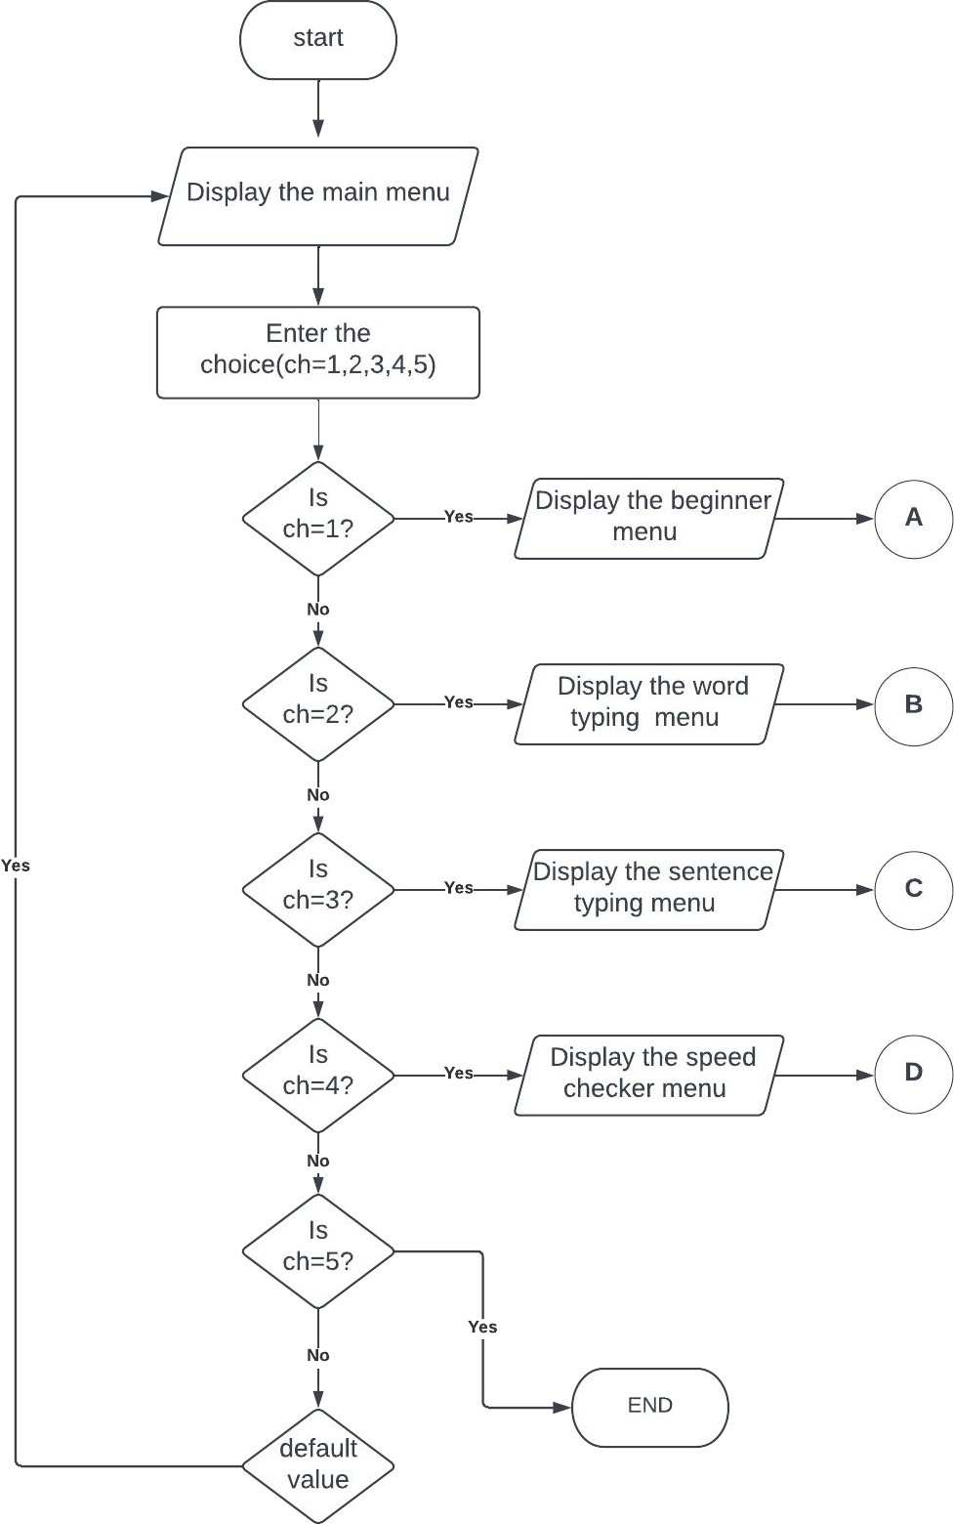
FLOWCHART

Slide 9
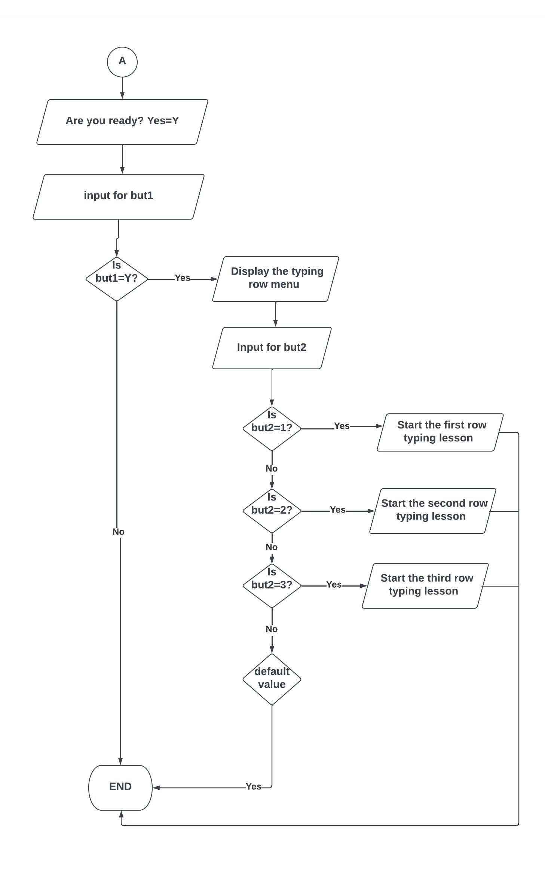

Slide 10
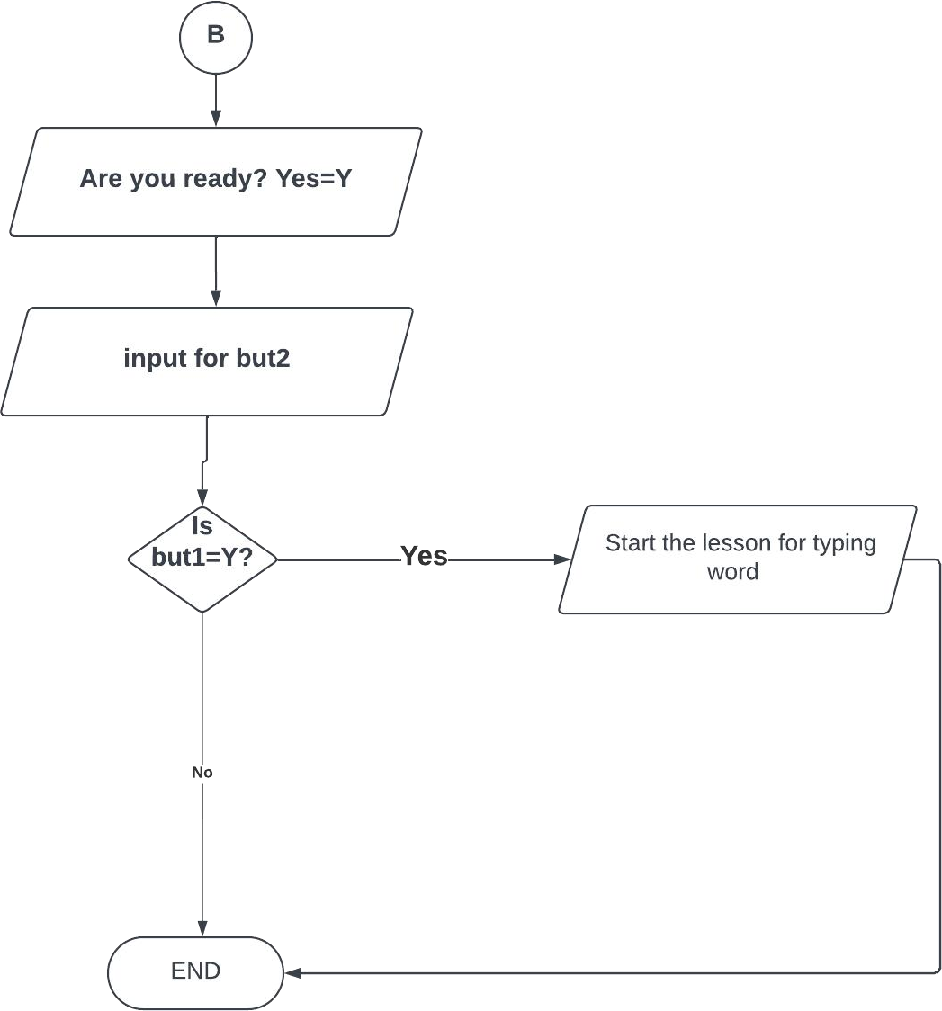

Slide 11
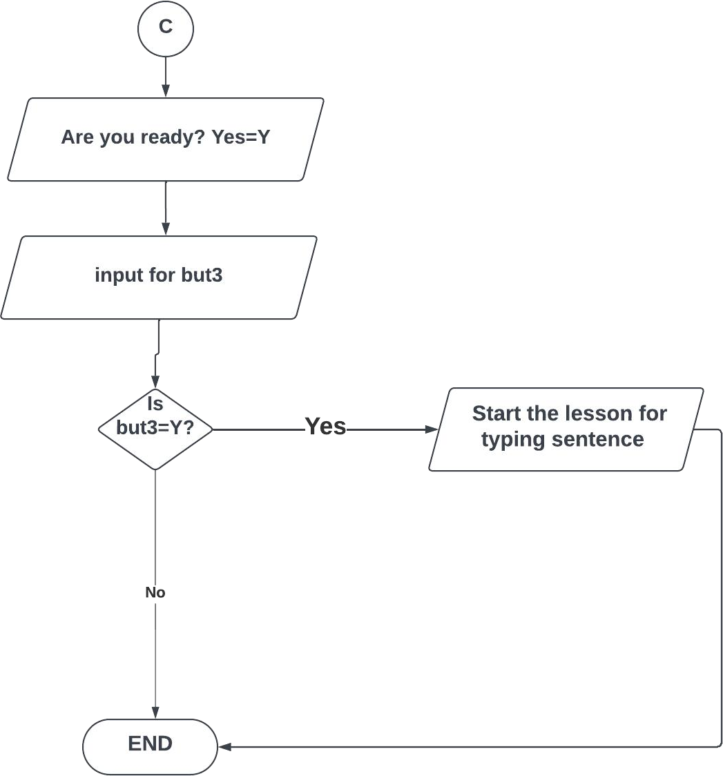

Slide 12
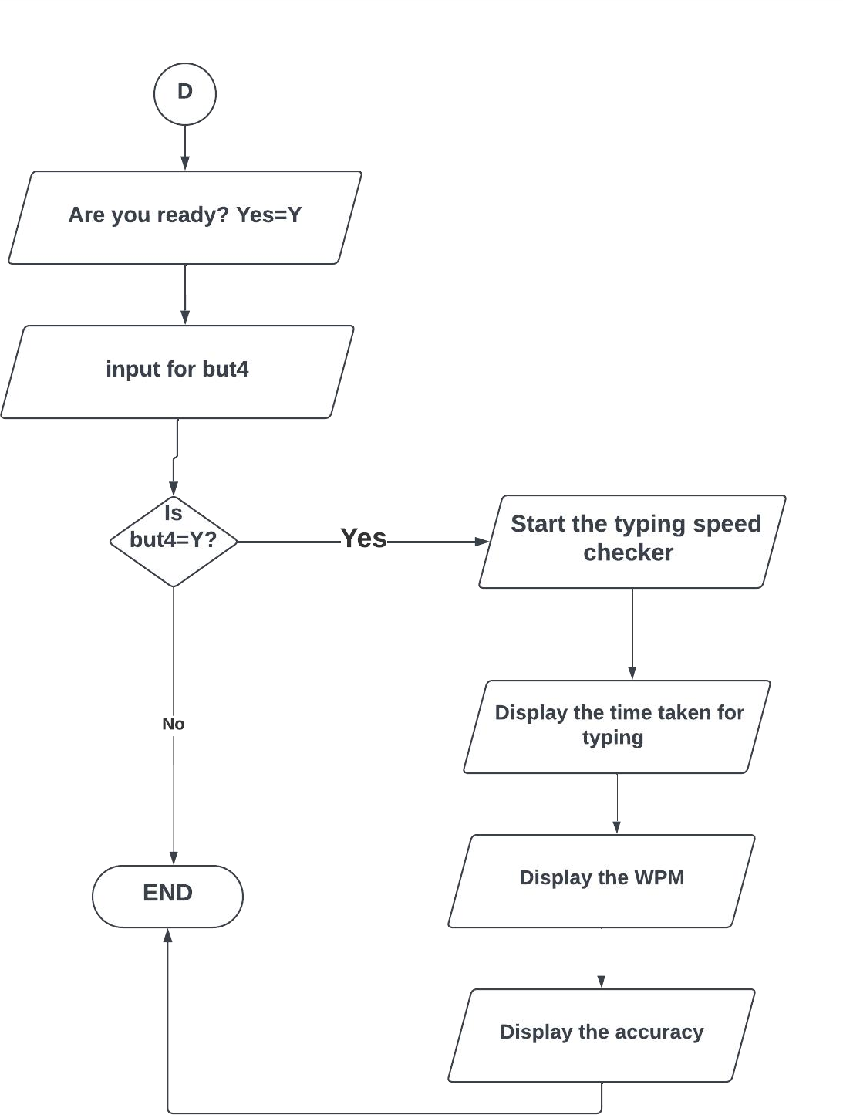

Slide 13
LIMITATIONS
Free time is needed.
The simple truth is that you have to work to get results.

Slide 14
FUTURE ENHANCEMENT
Better UI design.
Keeps the record of the user.
Add a timer in the speed checker.

Slide 15
CONCLUSION
In general, Typing Master is a brainstorming tool which helps an individual to increase his/her typing skills as well as gives some important information.

Slide 16
THANK YOU….!!

